Slide 1


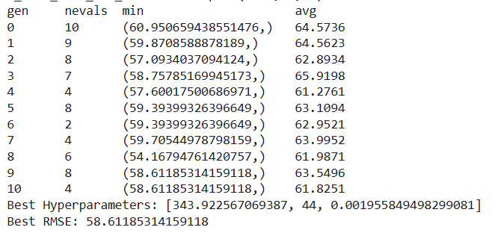
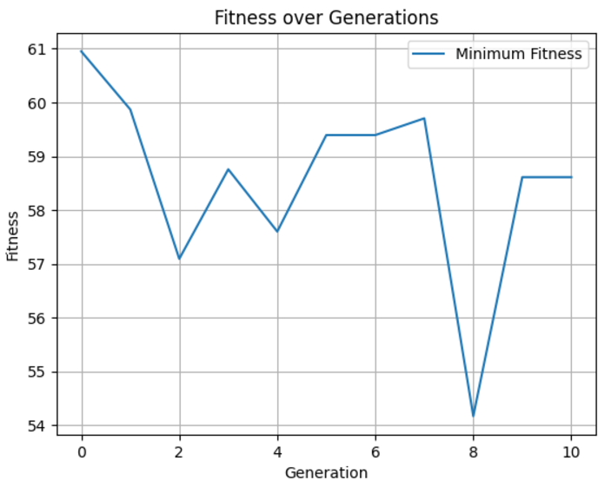
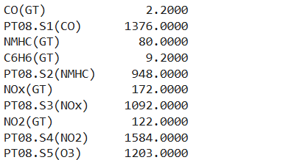
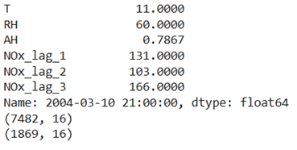
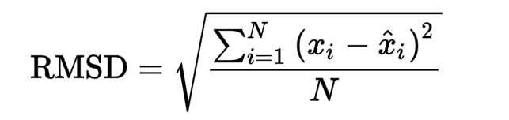
Air Quality Time Series Hyperparameters optimization using Evolutionary Computation methods
Batyr Kenzheakhmetov, Ryan Kaddis, Prerak Patel, Devson B., CJ Chung
College of Arts and Sciences, Lawrence Technological University
ABSTRACT
METHODOLOGY
EXPERIMENTAL RESULTS
This study evaluates the performance of LSTM/GRU-based neural networks for predictive modeling, utilizing Evolutionary Computation methods, including Evolution Strategies (ES) and the DEAP framework, to optimize hyperparameters. This study focuses on predicting Total Nitrogen Oxides (NOx), with the goal of decreasing an RMSE metric.
Evolutionary Computation methods used in this project are ES(1+1) with 1/5 Rule, ES(N+M) and DEAP library.
The lowest loss of 40.99 was achieved with 115 RNN units + 3 DNN layers(64, 128, 27 neurons), 12 lags, a learning rate of 0.001 using ES(N+M). These results demonstrate the effectiveness of fine-tuning hyperparameters for minimizing loss.
Baseline Model: Initial models used default LSTM and GRU configurations to establish baseline performance, measured by Root Mean Squared Error (RMSE).
Evolutionary Optimization:
ES(1+1) with 1/5 Rule: Optimized basic hyperparameters (neurons, learning rate, batch size, activation function) and specific parameters (lags, timesteps).
Using number of epochs: 50
Possible activation functions are relu and elu and possible optimizers are RMSprop and Adam. The reason for this, because other activation functions and optimizers showing bad performance.
The minimum learning rate here is 0.001, since the low learning rate leads to the NoN value y_prediction problem.
ES(N+M): Extended optimization to include structural parameters
Structural parameters : number of neurons in GRU layer and in three DNN layers, learning rate and number of lags.
Uses the Adam optimizer and ReLu activation function.
All models went for 50 generations
Batch size: 32
Epochs=100
N = 2: The number of parent individuals selected for generating offspring in the next generation.
M = 2: The number of offspring generated by the parents in each generation.
DEAP Framework: Applied for population-based exploration of hyperparameter space, combining mutation and selection mechanisms for efficient optimization.
Encodes hyperparameters as a list of values: number of neurons, batch size, learning rate.
Uses the Adam optimizer and ReLu activation function.
Uses EarlyStopping to prevent overfitting during training.
Mutates by applying Gaussian noise to individual attributes (hyperparameters).
Model I: ES(1+1) with 1/5 Rule
Trial | RNN type | # neurons | # lags | Learning rate | Batch size | Activation function | Optimizer | Loss | Iterations
1 | LSTM | 332 | 4 | 0.001000 | 15 | relu | Adam | 53.793950 | 10
2 | LSTM | 281 | 3 | 0.001000 | 15 | elu | RMSprop | 58.379630 | 12
3 | LSTM | 250 | 2 | 0.001000 | 17 | relu | Adam | 59.572110 | 6
4 | LSTM | 300 | 3 | 0.001000 | 15 | elu | RMSprop | 57.356700 | 16
5 | LSTM | 321 | 2 | 0.001000 | 15 | relu | Adam | 56.737870 | 4
1 | GRU | 283 | 3 | 0.001000 | 10 | elu | RMSprop | 59.092310 | 7
2 | GRU | 287 | 6 | 0.001000 | 8 | elu | RMSprop | 59.303440 | 2
3 | GRU | 250 | 3 | 0.001000 | 11 | elu | RMSprop | 56.833080 | 7
4 | GRU | 328 | 3 | 0.001000 | 8 | elu | RMSprop | 58.476100 | 2
5 | GRU | 286 | 3 | 0.001000 | 8 | elu | RMSprop | 59.760440 | 4
INTRODUCTION
The accurate prediction of Total Nitrogen Oxides (NOx) emissions is a critical task in environmental monitoring and air quality management. Predictive modeling, particularly using Long Short-Term Memory (LSTM) networks, has demonstrated significant promise for time-series forecasting in atmospheric science [1]. Recent studies, such as those by Zhang et al. [2] and Kumar et al. [3], have shown the effectiveness of deep learning models, including LSTM and GRU, in capturing complex temporal dependencies in pollutant concentration data. However, optimizing these models remains a challenge, as hyperparameters significantly influence model accuracy and computational efficiency.
This research utilizes Evolutionary Computation techniques, specifically Evolution Strategies (ES) and the DEAP framework, to optimize LSTM hyperparameters. These methods allow systematic exploration of hyperparameter spaces, outperforming traditional grid or random search methods in terms of efficiency and effectiveness [4, 5].
Table 1. Results of ES(1+1) with 1/5 Rule
Model II: DEAP
DATASET
DISCUSSION
Baseline Model Performance:
Initial experiments using LSTM and GRU models demonstrated moderate forecasting performance with a baseline root mean square error (RMSE) of 62.49. These results highlight the complexity of the problem, especially when accounting for long-term dependencies and seasonal patterns in air quality data.
Optimization with Evolutionary Computation:
The study used evolutionary strategies (ES) and the DEAP framework to optimize key hyperparameters, including the number of neurons, learning rate, batch size, and structural network configurations.The ES(1+1) method with the 1/5 rule showed progressive improvements in RMSE across iterations by optimizing both baseline and specific parameters such as time steps and delays. Notably, the best LSTM configuration achieved an RMSE of 53.79, highlighting the ability of the method to refine models to improve accuracy.
The ES(N+M) strategy further optimized the number of delays and neurons in combination with the configurations of the deep layers of the network. The best results were obtained, achieving the lowest RMSE of 40.99.
Efficiency of Evolutionary Computation:The results show that evolutionary computation methods are very effective for tuning hyperparameters in deep learning models. Unlike traditional grid or random search methods, ES and DEAP allow adaptive and efficient exploration of the hyperparameter space, achieving significant RMSE reduction.The ability of these methods to avoid local minima and converge to near-optimal solutions is well suited to the requirements of complex time series forecasting problems.
The UCI Air Quality Dataset provides hourly air quality data, including CO, benzene, temperature, relative humidity, and NOx. After preprocessing, NOx is used as the target variable, with other features as predictors. Data is split into 80% training and 20% testing sets.
UCI Machine Learning Repository. Air Quality Dataset. Available at: https://archive.ics.uci.edu/ml/datasets/air+quality
Figure 2. Results from model with using DEAP library 1 (Batyr K.)
Model III: ES(N+M)
Trial | RNN type | # TimeSeries Units | # 1 layer Units | # 2 layer Units | # 3 layer Units | # lags | Learning rate | Loss
1 | LSTM | 115 | 64 | 128 | 27 | 12 | 0.0010 | 40.985500
2 | GRU | 36 | 64 | 98 | 32 | 12 | 0.0993 | 47.710293
3 | LSTM | 110 | 64 | - | - | 12 | 0.0494 | 42.379280
Table 2. Results of ES(N+M) with 1/5 Rule
Figure 1. An example of what a date looks like
FUTURE WORK
REFERENCES
RESEARCH GOALS
While this study demonstrates the effectiveness of Evolutionary Computation methods, including Evolution Strategies (ES) and the DEAP framework, in optimizing LSTM/GRU-based models for air quality time series forecasting, several avenues for future research can be explored to further enhance predictive accuracy and model robustness:
1. Integration of Additional Features:
Future studies could incorporate more comprehensive environmental and meteorological data, such as wind speed, solar radiation, and traffic patterns, to improve the predictive capability of the model.
2. Exploration of Advanced Architectures:
- Investigating advanced deep learning architectures like Transformer models or hybrid networks (combining CNNs with LSTMs) may offer improved performance for capturing long-term dependencies and complex spatial-temporal relationships.
- Applying ensemble learning techniques that combine the predictions of multiple optimized models might also enhance overall prediction accuracy.
3. Dynamic Hyperparameter Optimization:
- Incorporating adaptive hyperparameter optimization techniques that evolve during training, such as population-based training (PBT) or meta-learning strategies, could result in better performance compared to static optimization approaches.
Hochreiter, S., & Schmidhuber, J. (1997). Long Short-Term Memory. Neural Computation.
Zhang, X., et al. (2020). Deep learning models for air quality prediction: A comprehensive review. Atmospheric Environment.
Kumar, A., et al. (2021). Predicting air pollutant concentrations using deep recurrent neural networks. Environmental Science and Pollution Research.
Schwefel, H.-P. (1995). Evolution Strategies: A Comprehensive Introduction. Springer-Verlag.
Fortin, F.-A., et al. (2012). DEAP: Evolutionary algorithms made easy. Journal of Machine Learning Research.
UCI Machine Learning Repository. Air Quality Dataset. Available at: https://archive.ics.uci.edu/ml/datasets/air+quality
The primary goal of this study is to decrease a Root Mean Square Error (RMSE) for predicting NOx levels, by using Evolutionary Strategies and DEAP Framework.
To this end, the research explores the potential of Evolutionary Computation methods in fine-tuning LSTM models for time-series forecasting.
RMSE metric formula:
Additional Goals:
To find out the effectiveness of Evolutionary Computation for hyperparameter optimization
Write an adaptive program for other similar problems with Time Series
Reduce training time.
Understand which evolutionary computation method is suitable for such problems

